Slide 1
First think then speak.
Two heads are better than one.
A sound mind
in a sound body.

Slide 2
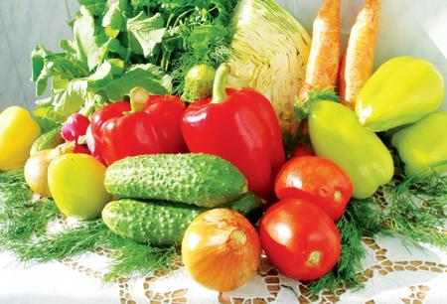
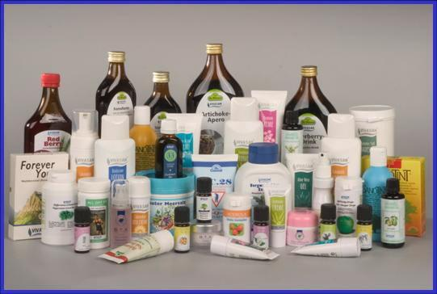
A sound mind in a sound body.

Slide 3
must –должен
mustn’t – нельзя
should –следует
shouldn’t –не следует

Slide 4
Kids like doing things together
In a cold or frosty weather.
But they should put on warm coats
Not to have an awful throat.
If they have the flu or cold
To the doctor they must go.
They should follow his advice.
And must not eat snow and ice.

Slide 5
Headache, toothache no matter
Stay in bed, you must get better.
You should drink a lot of tea
Wait for doctors, they will see.
Kids all must be fit and healthy.
It will make them bright and wealthy.
They should sport and eat good food.
Then they will be in good mood.

Slide 6
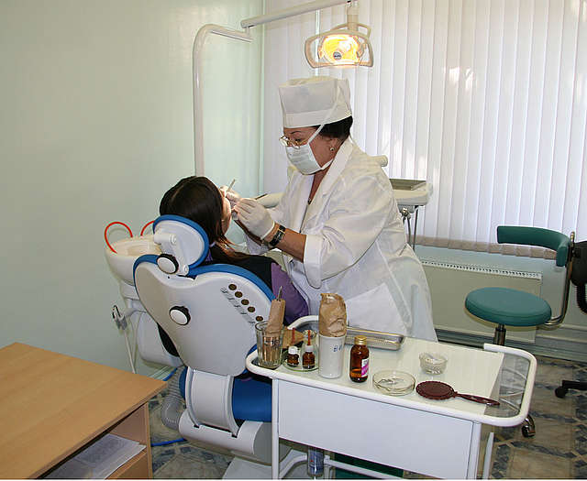
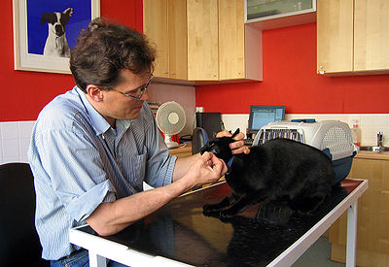
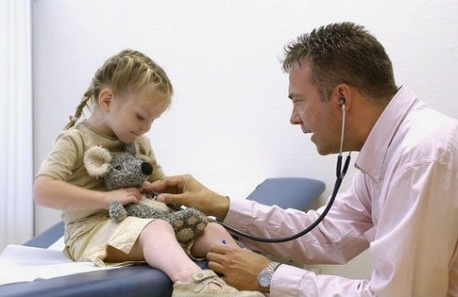
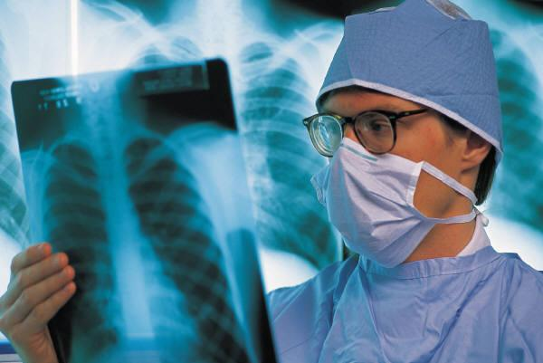
Room №
1
Room №
4
Room №
3
Room №
2

Slide 7
A sound mind in a sound body.

